Slide 1
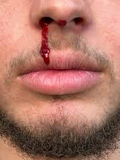
MANAGEMENT OF EPISTAXIS
BY NURSE ALIYU IBRAHIM

Slide 2
Table of content
Definition.
Epidemiology
Anatomy and physiology of the affected organ
Blood supply
Causes
Sign and symptoms
classification
Types of epistaxis
Diagnostic evaluation
Management
Nursing management
Complications
Conclusion
Refrences

Slide 3
DEFINITION
Bleeding from inside the nose is called epistaxis, is a sign and not a disease per se, an attempt should be made to find its any local or constitutional cause.
Nose bleed may occur from the anterior portion (kiesselbach’s plexus) or posterior part on the nose (woodruff’s area), It can be unilateral or bilateral.

Slide 4
epidemiology
Approximately 50% of population experience nosebleed at least once their life but it is serious enough to seek medical consultation in less than 10%, most patients present as an emergency.
AGE
Children usually have mild anterior nasal bleeding while elderly have profuse posterior nose bleeding.
GENDER
Males are more affected than the female but after the age of 50years both gender are affected equally.
RACE
Its more common in Caucasian compaired with Africa-americans.
Mohan Bansal (2017)

Slide 5
Anatomy and physiology of the affected organ
Nose is the first organ of respiration, its located in the anterior mid of the face, its an osteo-cartilagenous framework covered by muscles, skin and mucus membrane, its divided anterior posteriorly into external nose and nasal cavity proper and medially by nasal septum into right and left nostrils.
Breathing
Olfaction
Humidification
Filtration
Resonance
Reflex action Etc.

Slide 6
Blood supply of the nose
Nose is richly supply by the branches of internal and external carotid systems, both on the septum and on the walls.
Internal carotid system
Anterior ethmoidal artery
Posterior ethmoidal artery
External carotid system
Facial artery (superior labial artery)
Maxillary artery (greater & lesser palatine arteries and sphenopalatine artery).

Slide 7
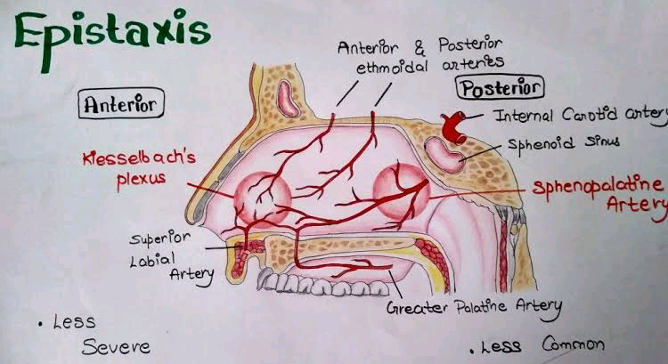

Slide 8
CAUSES
The common causes of children are
Major trauma
Nose picking
Rhinitis
Foreign body in the nose
Nasal injury
Nasal polyp
Nasal diphtheria
Nasopharyngeal tumors
Nasal spry abuse
Hot summer month

Slide 9
Other systemic causes:-
Leukemia
Hemophilia
Ingestion of aspirin
Vitamin K deficiency
Ca deficiency
Nephritis
Solar radiation
Acute infections
Thrombocytopenia

Slide 10
SIGN & SYMPTOMS
Signs of excessive blood loss include:
Dizziness
Weakness
confusion
fainting

Slide 11
classification of epistaxis
Anterior epistaxis Posterior epistaxis
More common
Mostly from Little's area or anterior part of lateral wall
Mostly occurs in children or young adults
Mostly trauma
Usually mild, can be easily controlled by local pressure or anterior pack
Less common
Mostly from posterosuperior part of nasal cavity
After 40 years of age
Spontaneous; often due to hypertension or arteriosclerosis
Bleeding is severe, requires hospitalization; postnasal pack often required

Slide 12
Other TYPES OF EPISTAXIS
Recurrent Epistaxis:- in recurrent nose bleeds the episode of bloods happens only at certain periods of time. Recurrent nosebleed can be seasonal. Its mostly happens when the weather get hot and dry.
Constant Epistaxis:- this is type of nose bleed that happens for a longer period of time. The bleeding is continuouse ( 45min).
Sudden epistaxis:- These are nosebleeds which could happen anytime of the day, regardless of the activity of the individual, Whether at rest or while active.
Chronic epistaxis:- nosebleed experienced for more then 6month. This type of bleeding happen as result of a chronic disease such as; Chronic liver or kidney disease, vascular malformation, long term use medication.

Slide 13
heavy nosebleed:- where there is a significant amount of blood coming out of the nose or post nasally and through mouth. in this type; immediate first aid treatment must be employed.

Slide 14
DIAGNOSTIC EVALUATION
  History
  Blood pressure
  Complete blood count
Coagulation studies
Angiography
Endoscopy
MRI
CT scan
X ray

Slide 15
General MANAGEMENT
First aid measures:-
Place the patient in a sitting position, leaning forward.
Apply direct pressure by pinching the entire soft lower portion of the nose for 5min.
Apply icepack to the nose and check area.
Loosing clothes and giving reassurance.
Gently insert a small gauze pad into the bleeding nostril and apply digital pressure if bleeding continues.
Take medical treatment if bleeding does not stop.
Identification of bleeding sit by a nasal speculum or headlight.

Slide 16

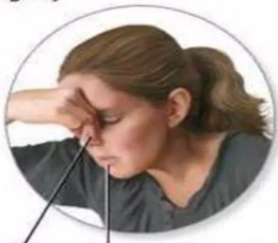
TROTTER'S METHOD
Sit and lean forward slightly
Pinch nostrils
Breathe through mouth

Slide 17
Anterior nasal bleeding:-
Anterior pressure packing
Use of an inflatible tampon
Silver nitrate application
Electrocautery
Posterior nasal bleeding:-
Posterior nasal packing with Cotton tampon
Radiologic embolization of the artery
Ligation of the internal maxillary artery
common drugs use:
Diacynone (etamsylate)
Vitamin k
Discontinuation of blood thinning e.g warfarin, aspirin

Slide 18
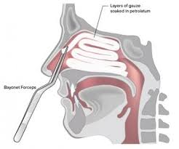
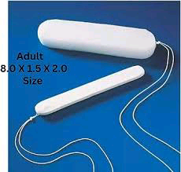
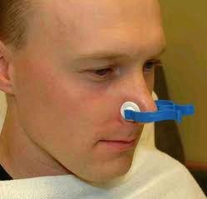
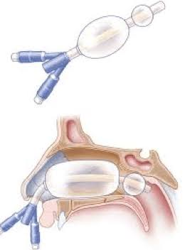

Slide 19
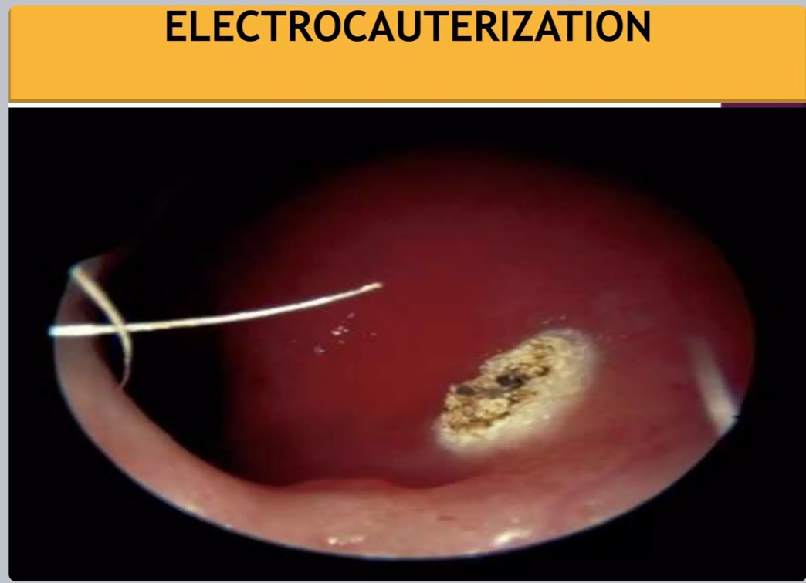

Slide 20
Nurse's role in the MANAGEMENT of epistaxis
Monitor vital signs.
Assisting in the control of bleeding .
Provide mackintosh, tissue paper and cottons and other PPE’s.
To instructed child to avoid aspiration of blood.
Nasal packing may alter respiratory status so closely monitor respiratory rate, heart rate, rhythm, LOC
Instruct the patient to avoid vigorous nasal blowing, strenuous activity, or lifting straining for 4-6 weak.
Also instructed to avoid nasal blowing or nose picking to avoid recurrence,
Instructions the patient to apply lubricant to nasal vestibule twice daily to reduce dryness.
Tidy up the scene and the tools used

Slide 21
COMPLICATIONs
Immediate complications
Hypotension
Anemia
Shock
Late complications
Secondary infection
Septal hematoma
Septal perforation
Nasal stenosis

Slide 22
Conclusion
Epistaxis or nosebleed is a common ENT emergency requiring prompt intervention, anterior epistaxis is mostly common and can be control with first aid measures while, posterior epistaxis can be severe However; its imperative to identify the root cause of the problem in other to provide definite solution. poorly manage epistaxis can lead to severe complications such as anemia and shock.

Slide 23
reference
    PL dingra Diseases of EAR, NOSE and THROAT. fourth edition ISBN 978-81-312-0327-9 page (166-170)
    Mohan Bansal diseases of the EAR, NOSE and THROAT. Third edition New Delhi by jaypee brothers medical publishers (P) LTD.
    How to treat anterior epistaxis with cautery By Waleed M Abuzeid. university of Washington revised july (2023) obtained online at https:www.msdmanuals.com/professional/ear,-nose,-and-throat-disorders/how-to-do-nose-procedures/how-to-treat-anterior-epistaxis-with-cautery
    Overview of nosebleed By Cleveland clinic medical professionals reviewed 17/4/2023. obtained online at https://my.clevelandclinic.org/health/diseases/13464-nosebleed-epistaxis
    Hospitalization forepistaxis: a population-based healthcare research study in Thuringia, Germany (2020). doi:10.1007/s00405-020-05875-2.
    common hemostatic drugs use in ent, Retrieved online @
    https://en.m.Wikipedia.org/wiki/etamsylate# accessed on 11/10/2023

Slide 24
Thank you for listening.

